Slide 1


Database Creation Final Project
Cit 225 - Miller, David Keith
Student – Giovanni Bruno Tiepolo
Theme – Cuts Clothing Website (https://www.cutsclothing.com/ )

Slide 2

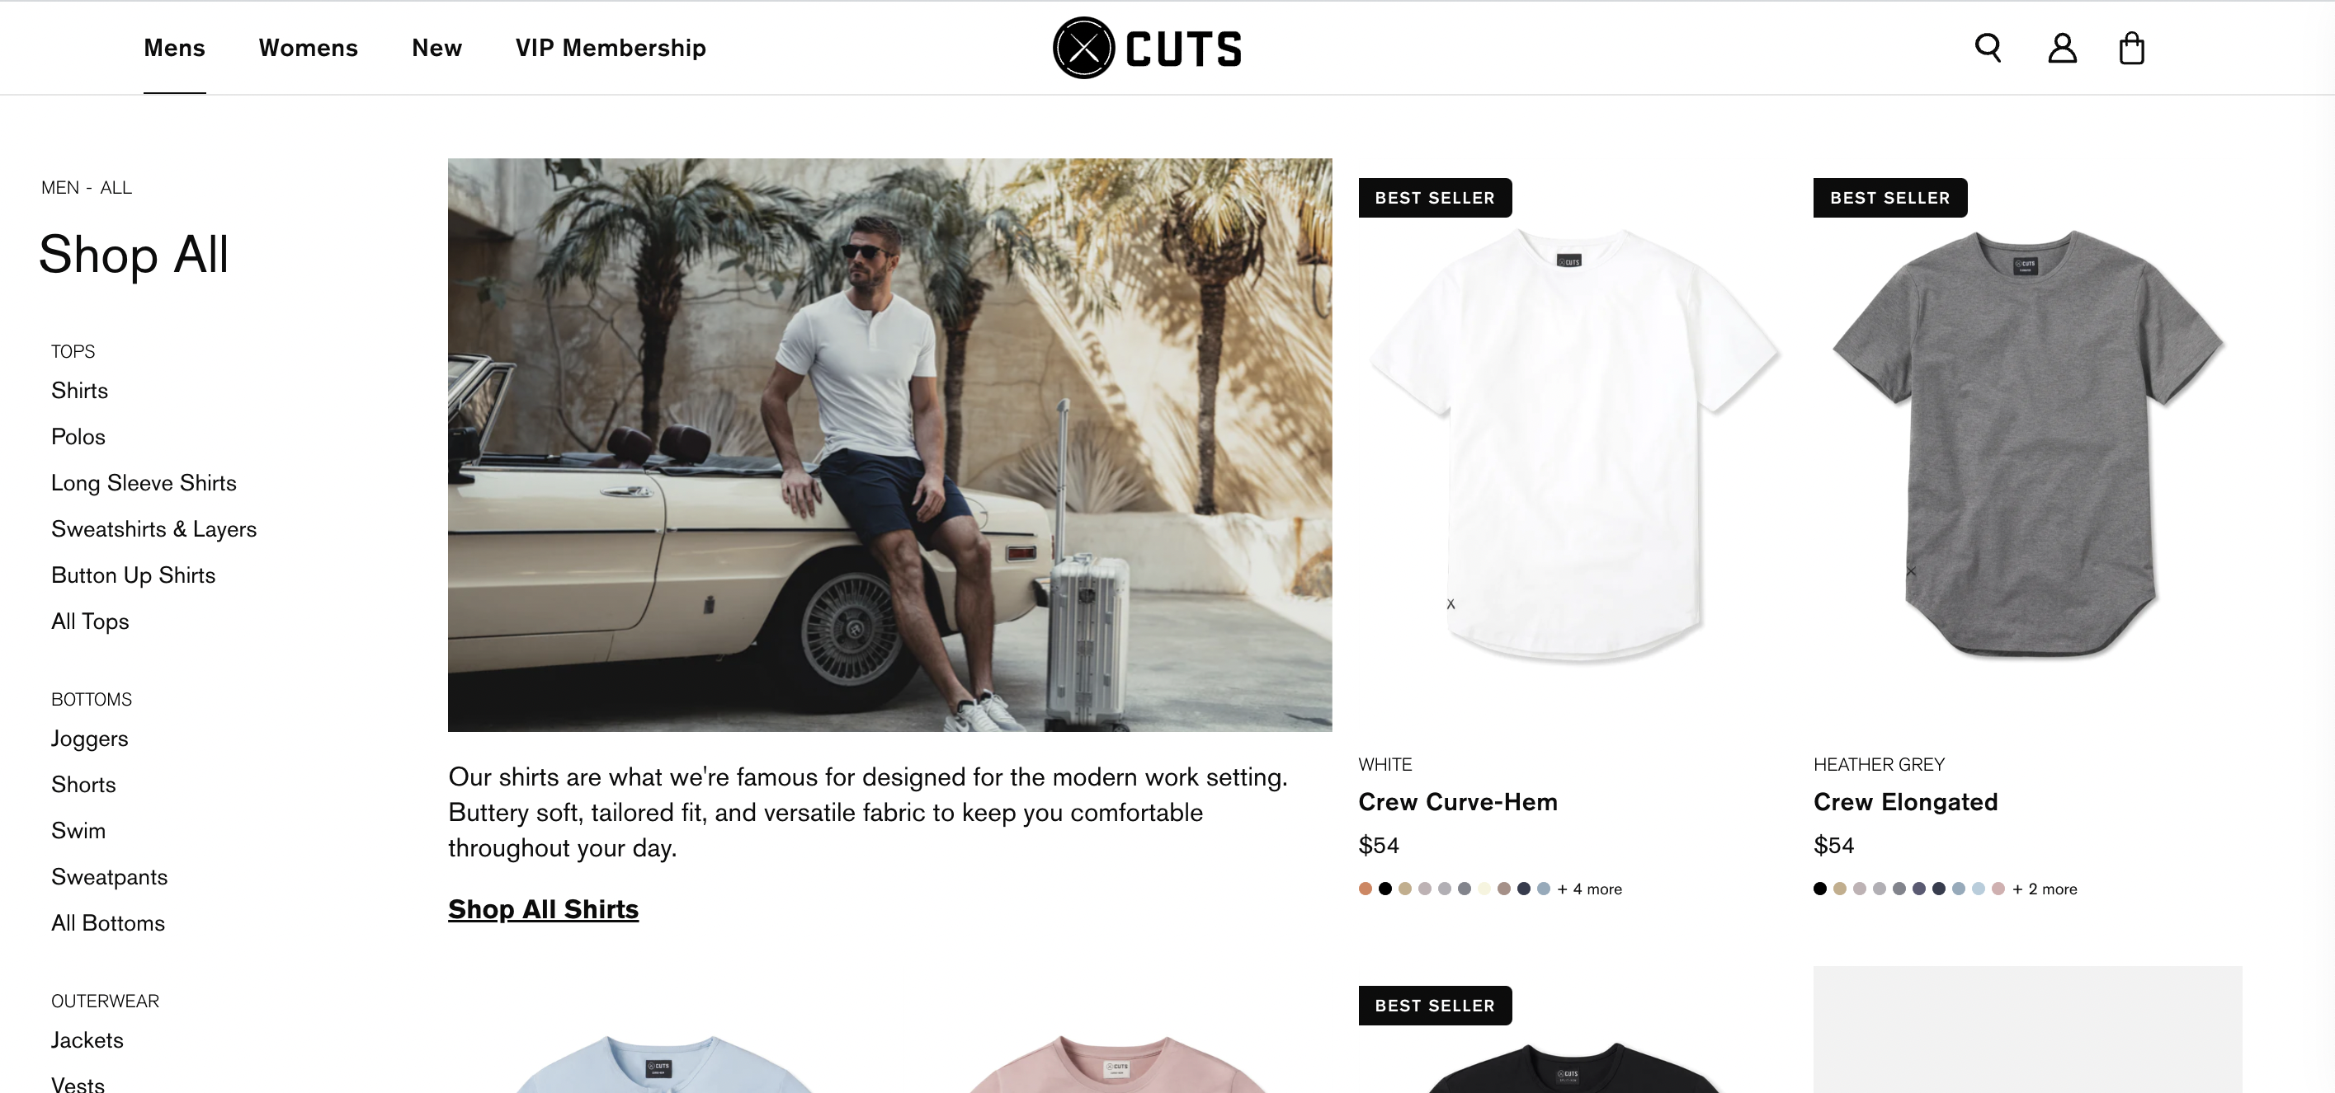
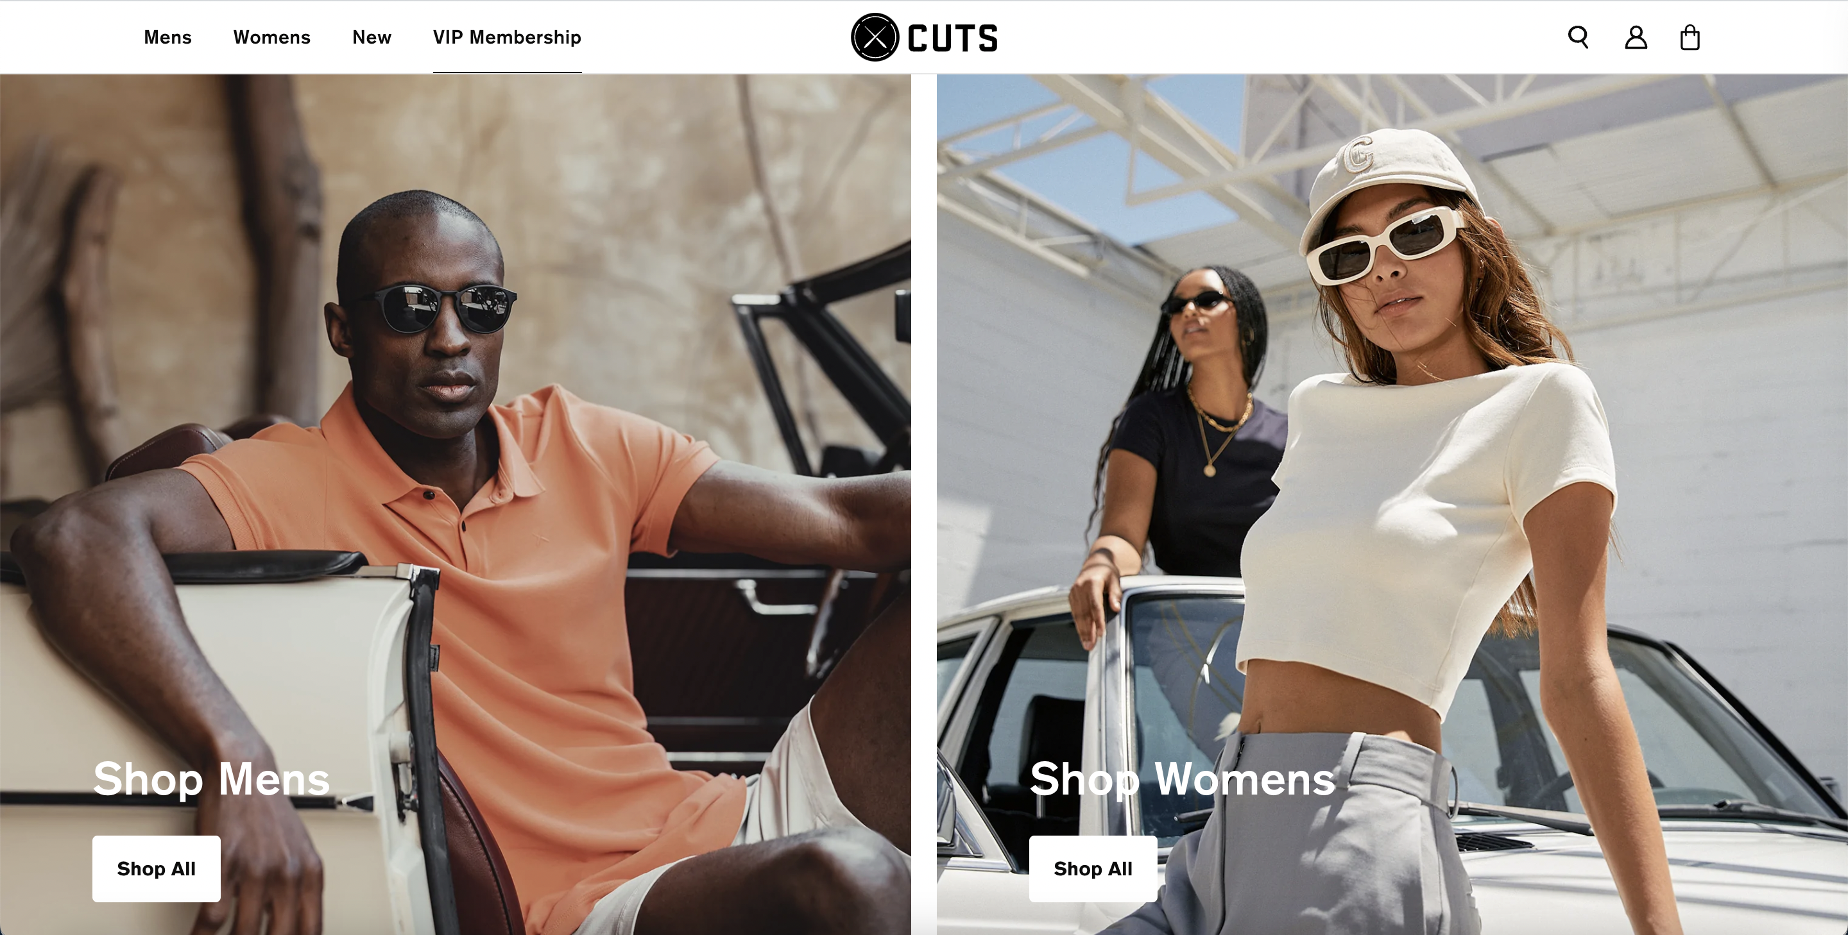
Cuts Clothing is a new clothing brand focused on a casual but also professional style, being able to use it everywhere (Recreation and at work).
In order to understand this little better about this brand, I created a database design on MySQL, trying to recreate the website, and how it stores information. In order to do it, I created 12 different tables on the MySQL diagram, and I will explain each one to you with practical examples.

Slide 3
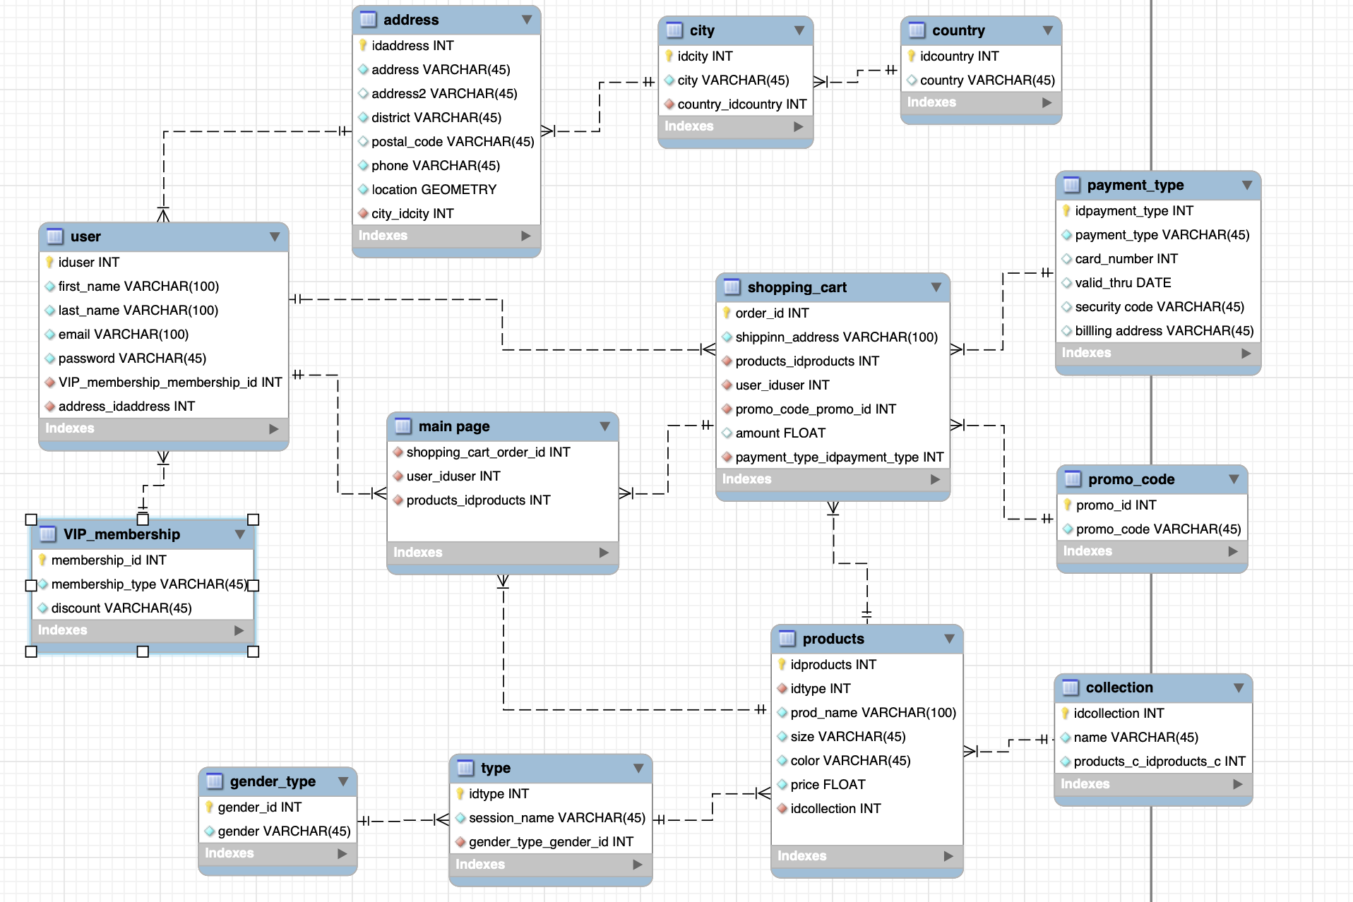

Database Structure & Model
The database model has four main tables.
They are User table, Shopping_cart, products, and main page.
I will be showing the details for each of the 12 tables in the next slides.

Slide 4
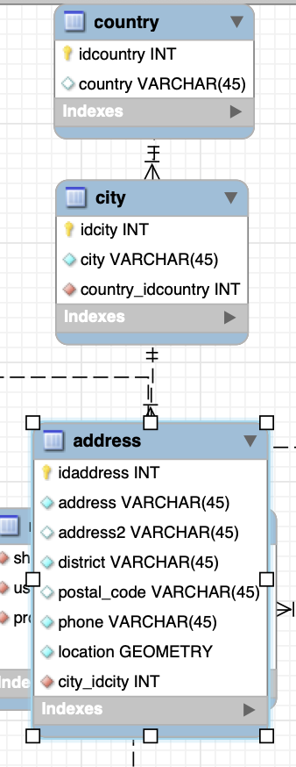
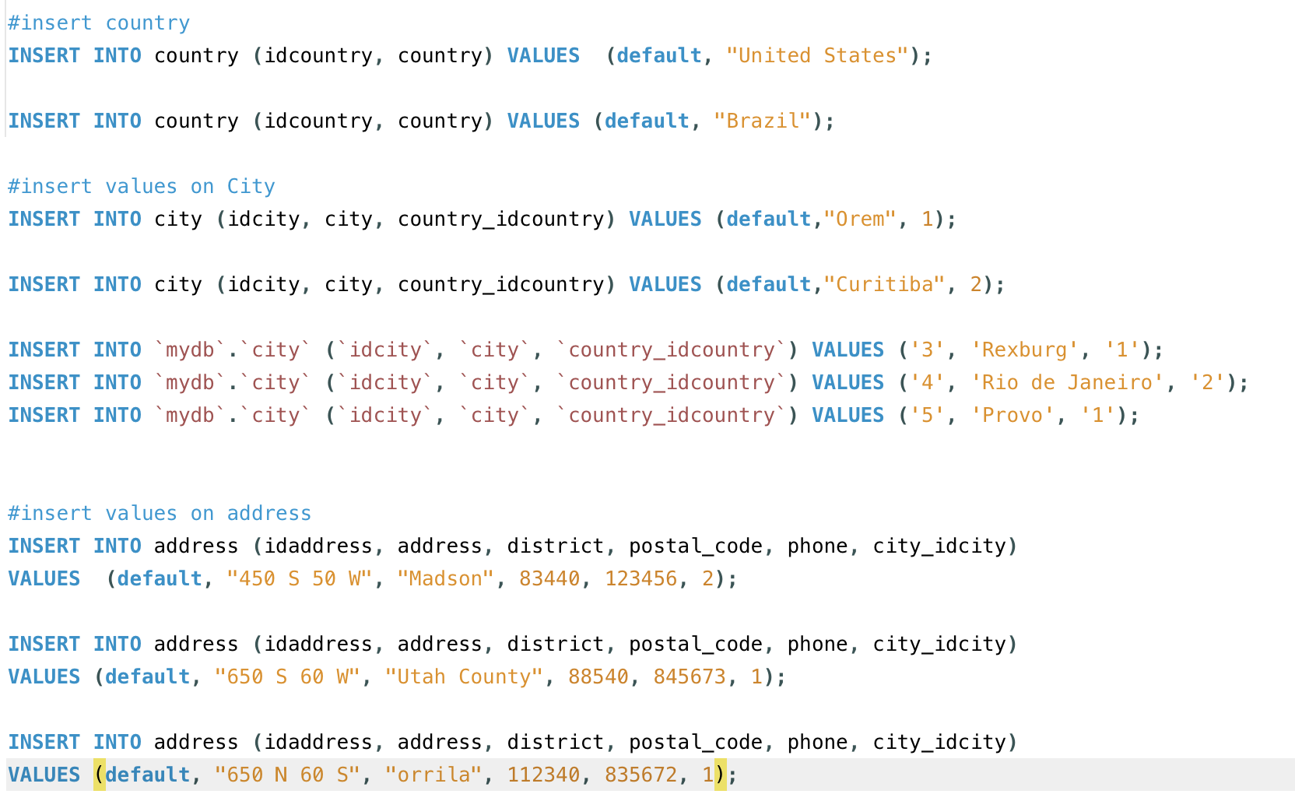
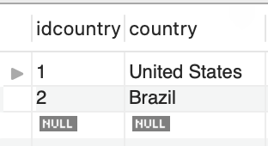
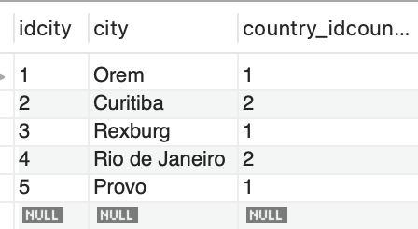
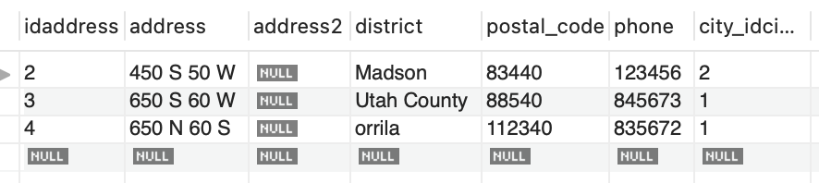
Country, City, and Address table are all tables created to better organize the user/customer data.
So, Country table has the “idcountry”, and the country name, it has a one-to-many relationship with the City Table, since one country has many cities, but one city has only one country.
The Address Table contains the user address. So, it has a one-to-many relationship with the User Table.
Here are examples of adding new data to this tables:
Country Table:
City Table:
Address Table:

Slide 5
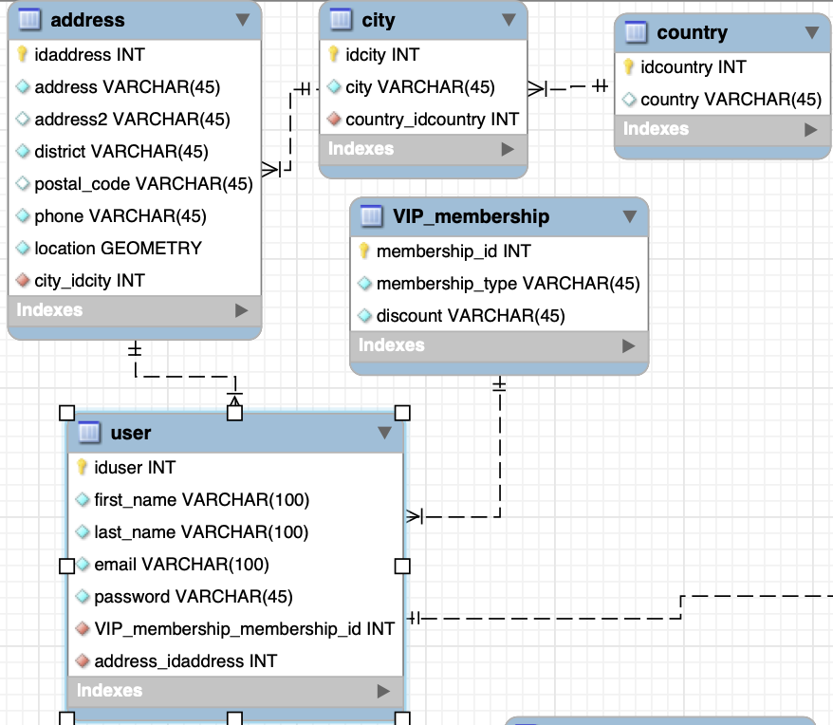
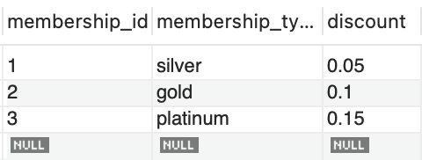
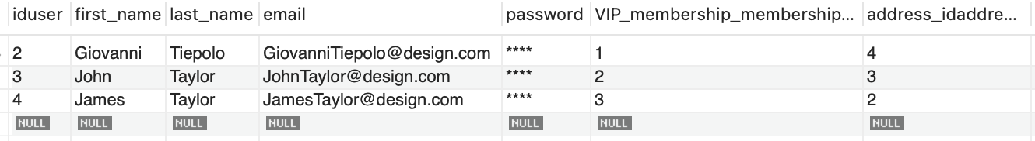
USER TABLE
The VIP membership table is related to a special membership that each customer can have, where the member can receive special discounts and early access to products.
Silver receive 5% discount,
Gold Receive 10% discount,
Platinum receive 15% discount.
User Table
The user table stores all the user information (name, email, and address).
Through the User table we can do deeper analyzes about the customer information in order to better promote the brand.
The following slide shows a practical example of how we can use this table for analyses

Slide 6
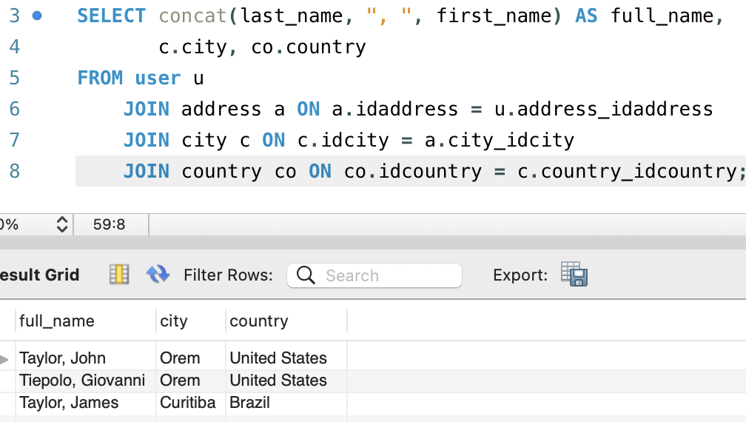
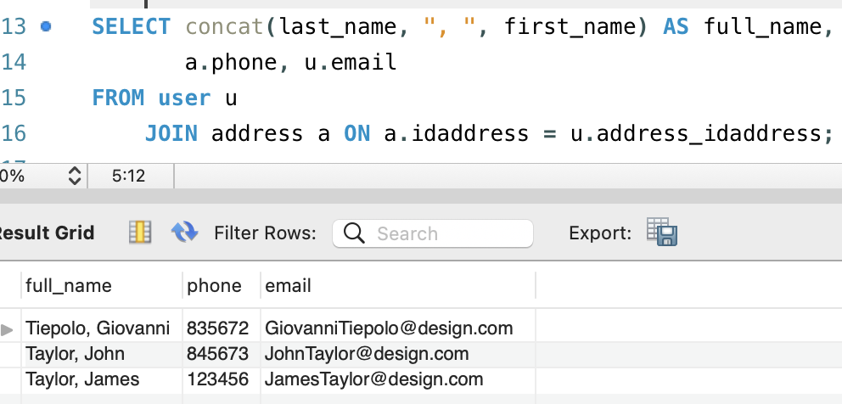
Customer Analysis
The following query helps us see where each of the customers are from:
The following query helps us filter the data to only see the user’s phone number and email. What makes it easier to send personalized promotional messages.

Slide 7
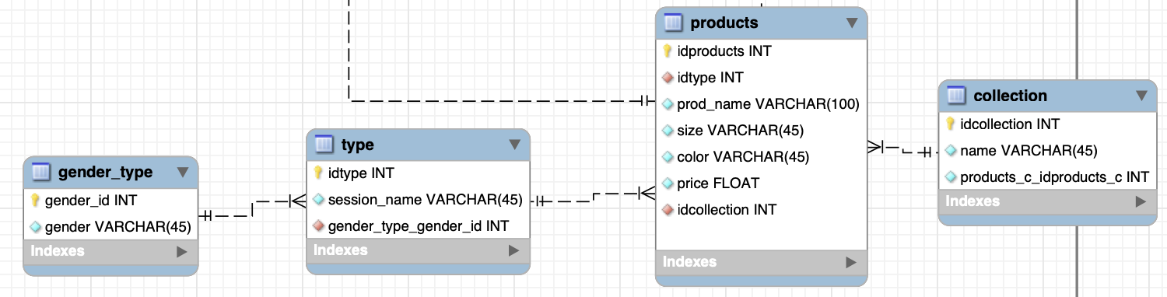
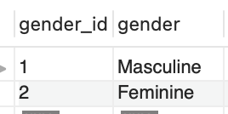
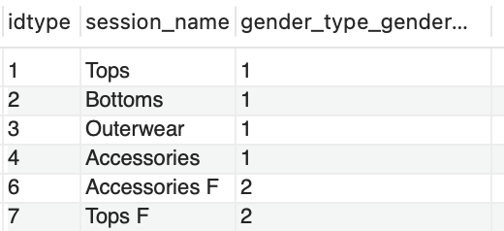
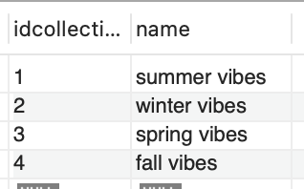
One of the main tables is the Products Table, it is linked by the gender_type, type, and collection table.
Gender_type: its table helps us separate the product by gender.
Type: this table shows each clothing session in the store.
Such as tops, bottoms, outerwear, and etc.
Collection: This table shows all the cloth collection in the store.

Slide 8
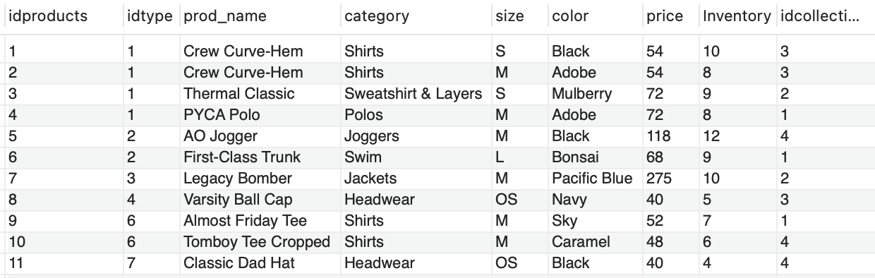
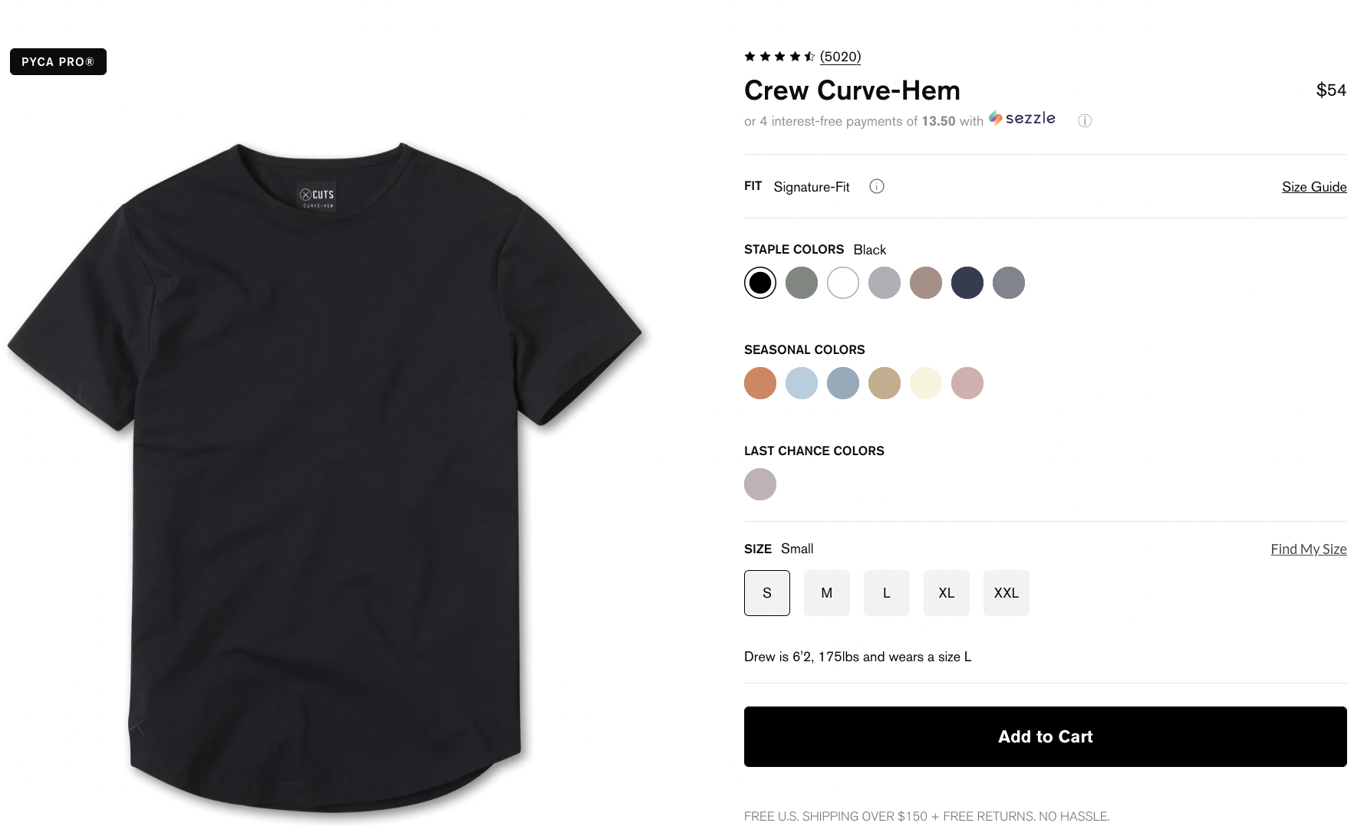
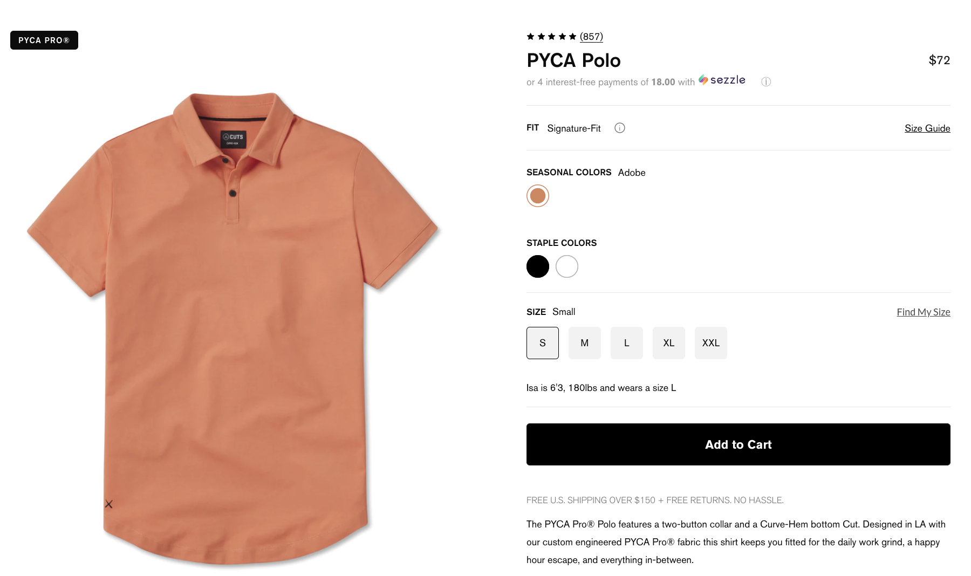
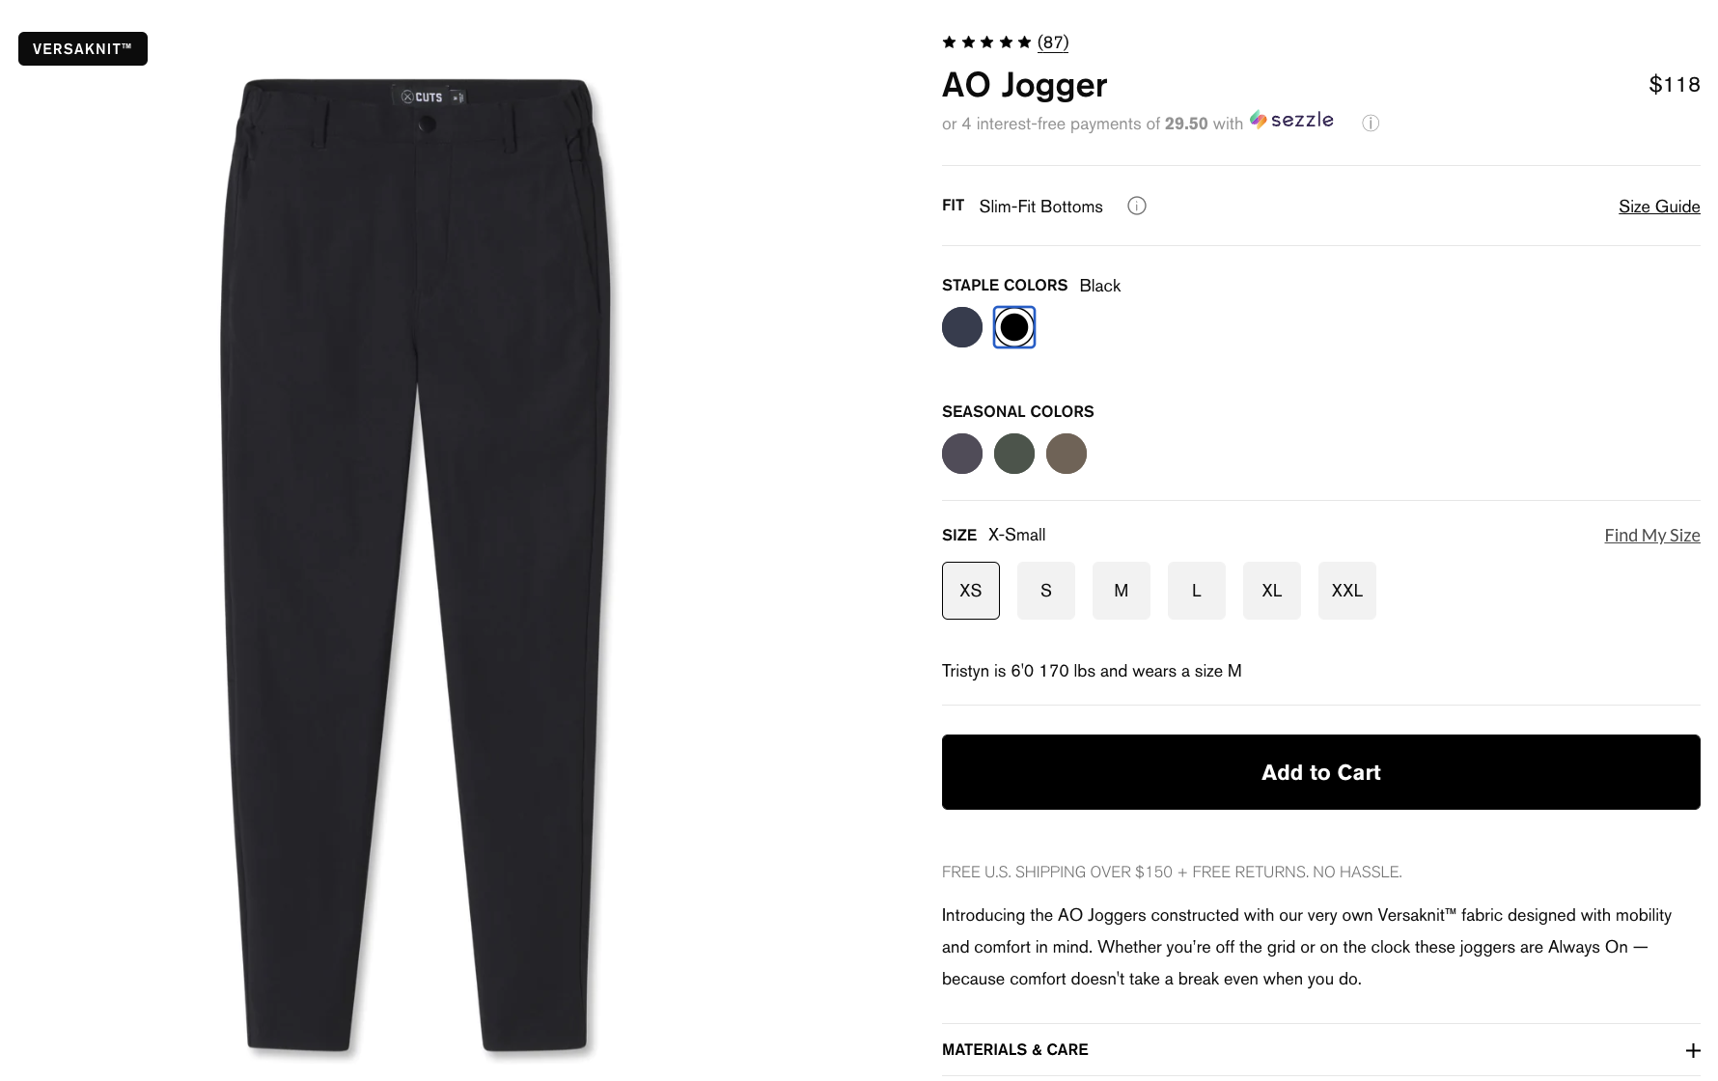
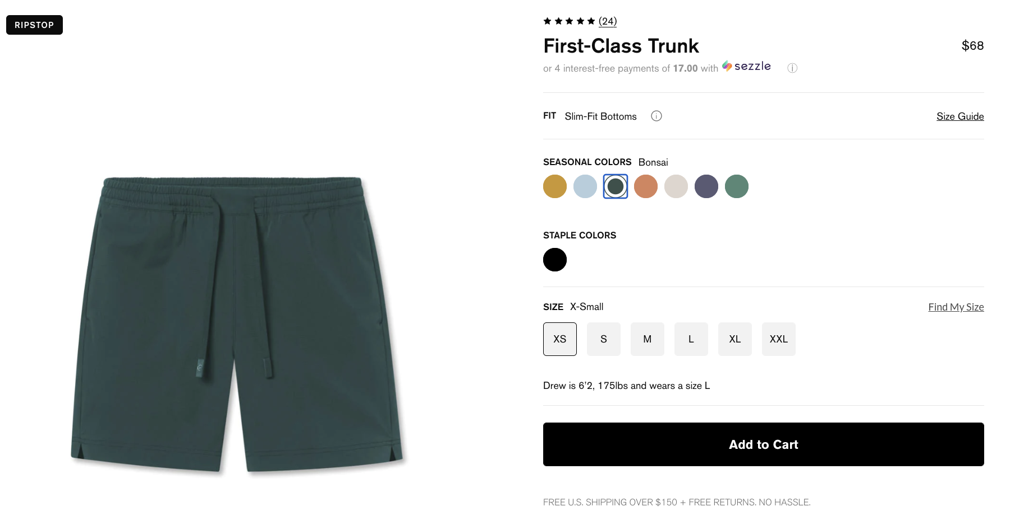
Products Table
The products table stores all the products available, showing its information, such as its price, color, category, inventory, etc.

Slide 9
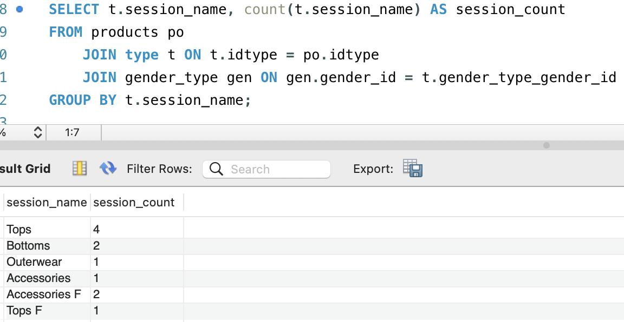
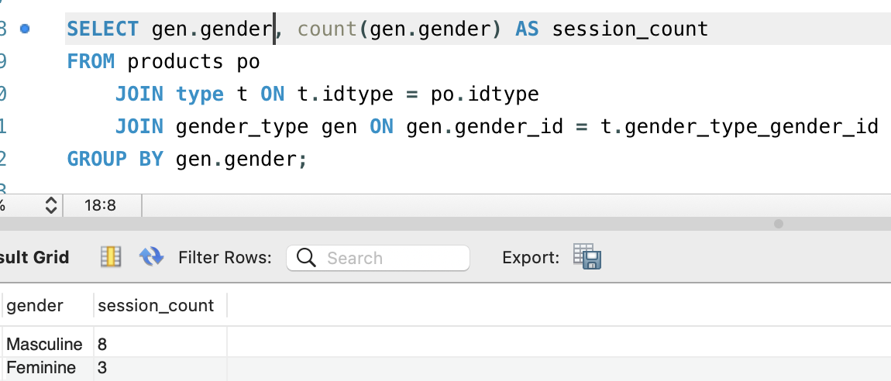
Products Scenario Analysis
How can I see how many masculine and feminine products we have? And also in what product sessions are our production focused?
The following query shows us how many products we have for each session. We can see that we have more Tops items than the other.
Here we can see that most of the products are for men since it is a men-focused brand.

Slide 10
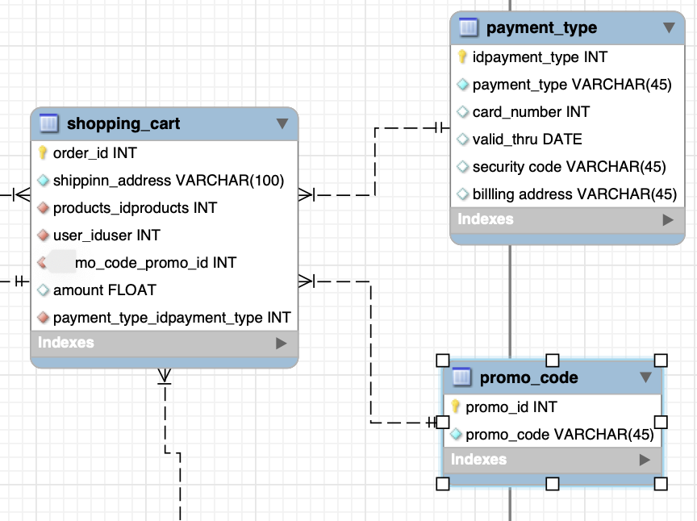
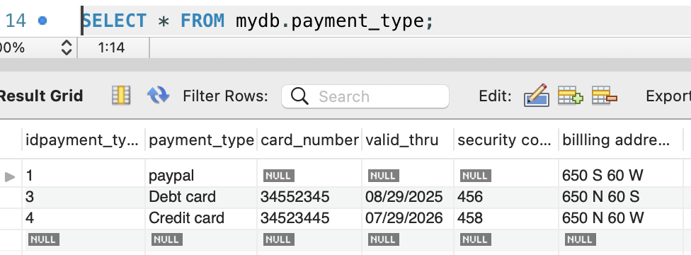
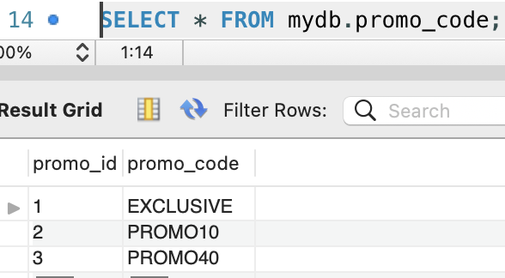
The Shopping_cart is one of the most important table of the diagram. It is connected with the product and user table. It also have a one-to-many relationship with the promo_code, and payment_type table.
Promo_code = this table is to store promo codes data, since there are different promo codes for just one shopping cart.
Payment_type = this table store all the payment type available in the web site, sch as PayPal, or debit/credit card payments.
Payment_type table:
Promo_code table:

Slide 11
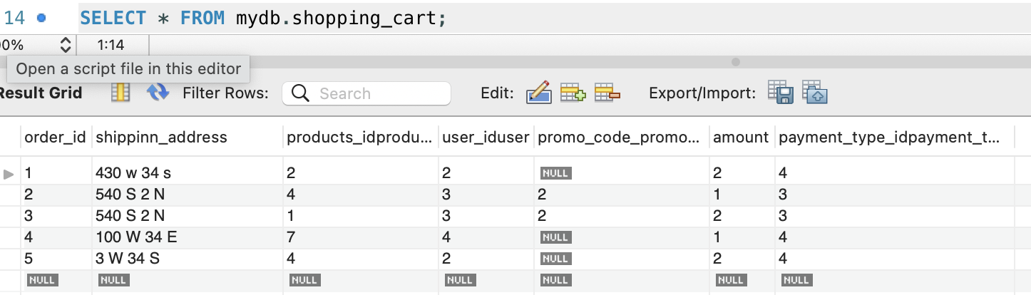
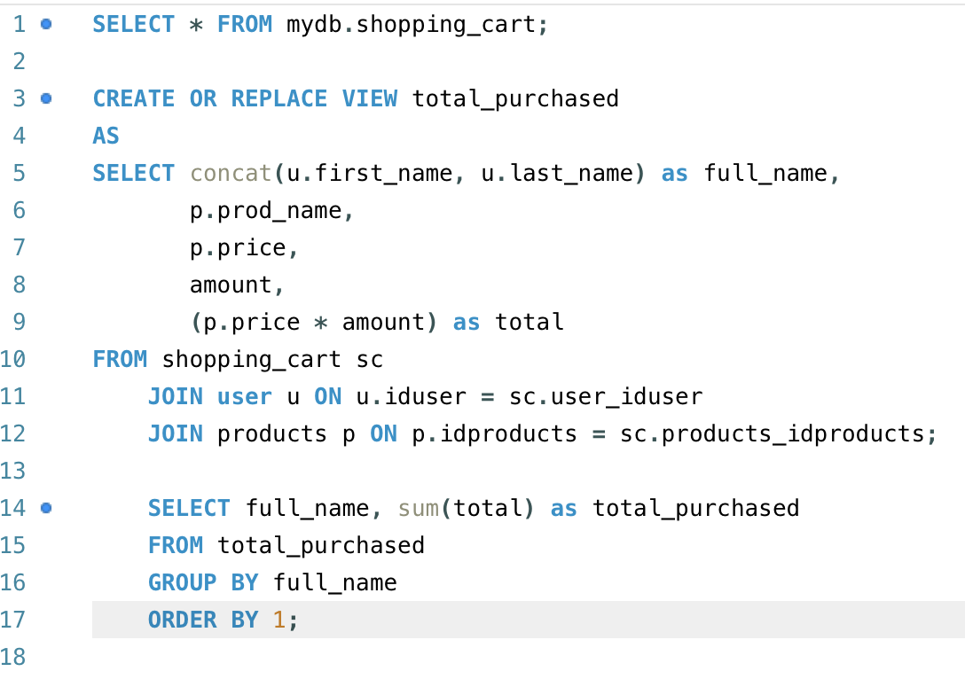
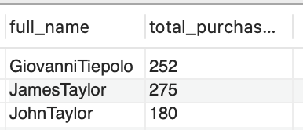
Shopping cart Table
This table store all the store’s transactions, having its amount bought for each item, and which customer order.
Shopping Scenario Analysis:
How can I see who are the most loyal customers?
In order to see who is the best customer. I created a view that store the total purchase by each customer transaction. Then using this view, I developed the query to show the customers the must amount of dollars purchased. Knowing it, we can better reward the most loyal customers.

Slide 12
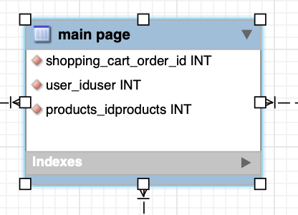
Main Page Table
The main page is a link to all the other tables. It is the website's main page, where we can connect to the products, and see all the products, or also connect with the user table in order to see each user's information. So, basically with the main page table, we can join it with all the other tables.

Slide 13
Conclusion
Working on the design and development of this database system was a great opportunity for me to test my MySQL knowledge. It helped me to deeply understand all the transactional processes of a company, the importance of storing the data right for better data analysis, and also be organized and make information flow normal in the business.
My final conclusion with this project is that a business without a good database is a business without a brain. All the knowledge and information of a business needs to be well stored and protected.

